Slide 1
Demystifying the Crystal Ball in Professional Sports
Eli V. Olinick, OREM Department, Southern Methodist University
Mark A. Husted and Alexandra M. Newman, ME Department, Colorado School of Mines
10/25/21

Slide 2
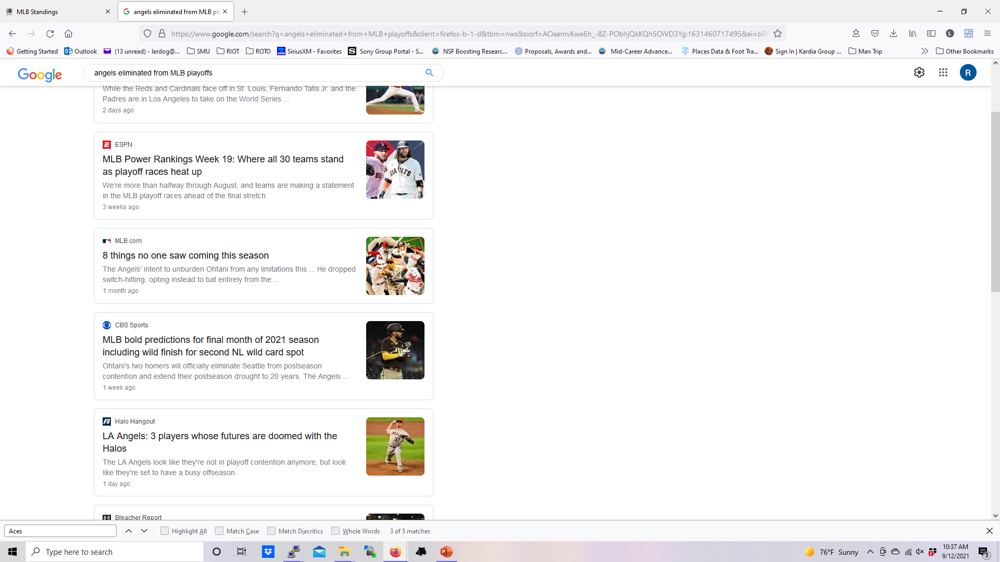
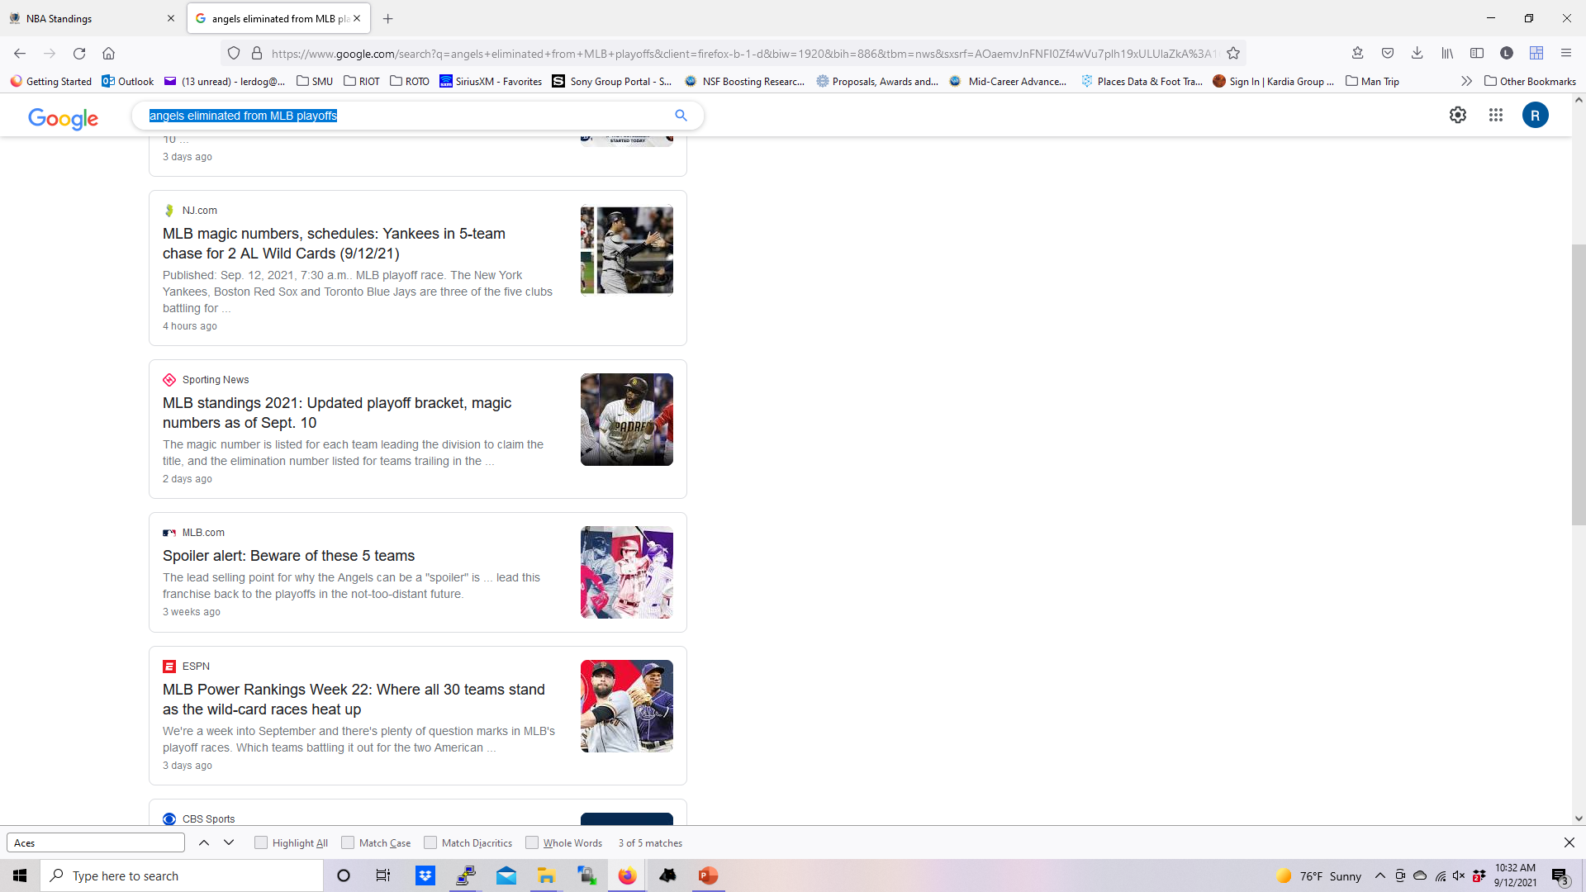
Sports Media’s Crystal Ball: Playoff Races and Magic Numbers
Notes:
Here’s an example of the sports media using their crystal ball to make predictions.
That’s entertaining, but we’re interested in this type of article.
The magic numbers in the headline are measures of how close teams are to clinching, or guaranteeing themselves, a spot in the post-season playoffs.

Slide 3

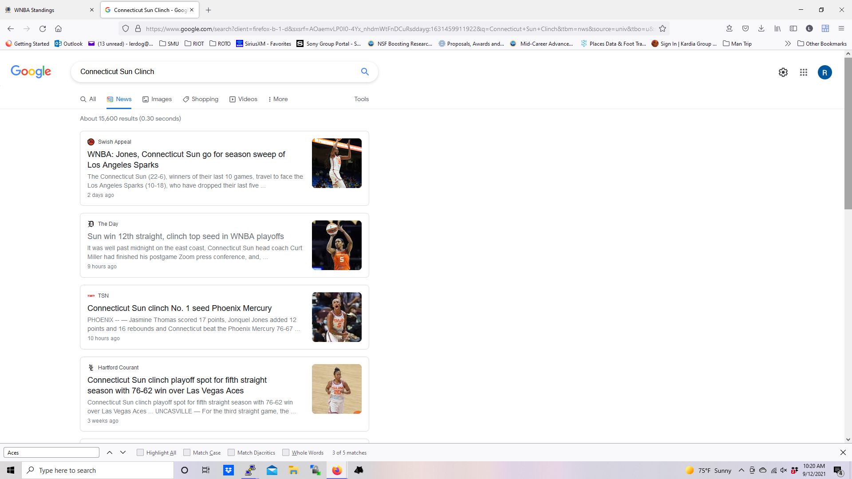

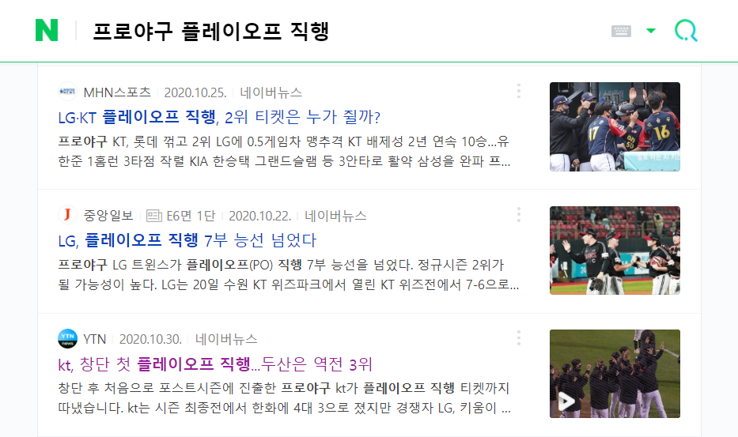
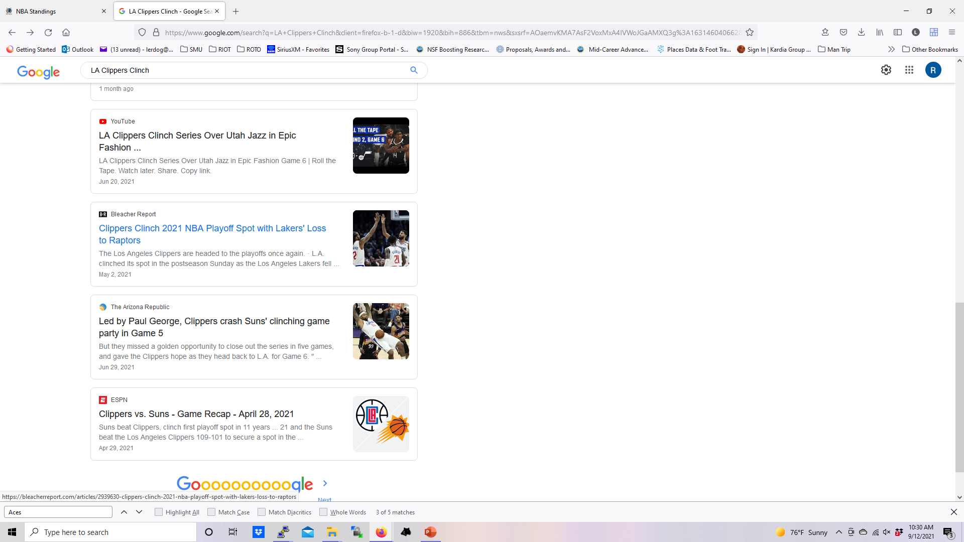
Playoff Races and Magic Numbers
Notes:
Sports media also use magic numbers to report when teams are eliminated from the playoffs (i.e., have fallen so far behind that they cannot qualify even if they win all of their remaining games).
They do this for all major sports.
It’s an international phenomenon.

Slide 4

RIOTSPORTS.net
Notes:
On the RIOT SPORTS website that Alexandra and I run, we use optimization models to calculate and post the number remaining games that the team in the leagues listed above must win to
Guarantee a first-place finish
Guarantee a postseason berth
Avoid elimination from first place
Avoid elimination from the postseason.
Recently, we have taken this a step a further and started posting justifications and explanations of the numbers we post.

Slide 5
Math Programming for Clinching and Elimination
M. A. Husted, E. V. Olinick, and A. M. Newman (2021)
Improving Sports Media’s Crystal Ball for NBA Playoff Elimination
T. Russell and P. Van Beek (2009)
Determining the Number of Games Needed to Guarantee an NHL Playoff Spot
E. Cheng and D. Steffy (2008). Clinching and Elimination of Playoff Berth in the NHL
C. C. Ribeiro and S. Urrutia (2005)
An Application of Integer Programming to Playoff Elimination in Football Championships
I. Alder, A. L. Erera, D. S. Hochbaum, and E. V. Olinick (2002)
Baseball, Optimization and the World Wide Web
L. W. Robinson (1991). Baseball Playoff Eliminations: An Application of Linear Programming
B. Schwartz (1966). Possible winners in partially completed tournaments
Notes:
This paper gives the origin story of the RIOT site, which was motivated in part by a seminal paper by Schwartz showing that the maxflow-mincut theorem gives necessary and sufficient conditions for elimination from fist place.
This is a just a sample of some of work that has followed from that. This is terrific work, but it’s written for ORMS audience. One of the RIOT project research questions is how do we explain the results to sports fans?
Often the proof that an optimization-based magic number is correct relies on showing that a MIP model is infeasible.
So, although fans enjoy tracking these numbers, most must take them on faith.
One of the current efforts in the RIOT project is automating the process of justifying magic numbers to sports fans in plain English.
Next, I’m going to illustrate the idea with the first-place elimination number.

Slide 6
Example First Place Elimination Numbers
Team | Wins | Losses | Games Left | FPE
Seattle | 16 | 5 | 11 | 1
Las Vegas | 15 | 6 | 11 | 2
Connecticut | 14 | 6 | 12 | 3
Minnesota | 14 | 7 | 13 | 3
Chicago | 10 | 10 | 12 | 7
… | … | … | … | …
Los Angeles | 6 | 13 | 13 | 11
Indiana | 4 | 16 | 12 | Eliminated
W + FPE = 17
Notes:
Here is an example based on our WNBA standings.
Like most standings pages, we list the teams, and how many game each team has won and lost so far.
We also list the number of games each team has left to play and their magic numbers. In this case, I’m only showing the first-place elimination numbers.
Notice that we’re indicating that Indiana has been eliminated from first place.
This is not obvious since they have 4 wins with 12 games left to play, which gives them the possibility of catching up to the first-place team, Seattle.
But, Seattle’s first-place elimination number is 1. That means that they must win at least one more game or else they will NOT finish in first place.
In other words, Seattle must get to at least 17 wins to stay in contention for first place.
Notice Las Vegas is in a similar situation. So is Chicago, and all the other teams that are not yet eliminated from first place.

Slide 7
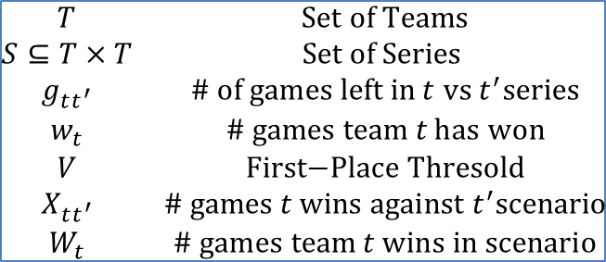
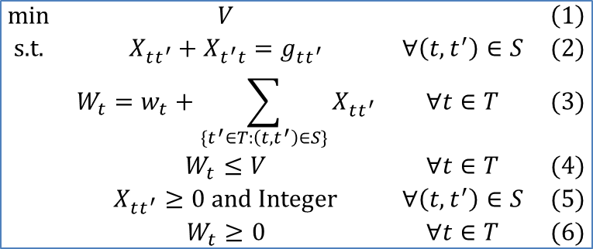
Threshold MIP
$$\begin{matrix}T & \text{Set} \text{of} \text{Teams} \\ S⊆T×T & \text{Set} \text{of} \text{Series} \\ g_{tt^{′}} & \text{\# }\text{of} \text{games} \text{left} \text{in} t \text{vs} t^{′}\text{series} \\ w_{t} & \text{\# }\text{games} \text{team} t \text{has} \text{won} \\ V & \text{First}\text{−}\text{Place} \text{Thresold} \\ X_{tt^{′}} & \text{\# }\text{games} t \text{wins} \text{against} t^{′}\text{scenario} \\ W_{t} & \text{\# }\text{games} \text{team} t \text{wins} \text{in} \text{scenario}\end{matrix}$$
$$\begin{matrix}\text{min} & V & & \left(1\right) \\ \text{s}\text{.}\text{t}. & X_{tt^{′}}+X_{t^{′}t}=g_{tt^{′}} & ∀\left(t,t^{′}\right)∈S & (2) \\ & W_{t}=w_{t}+\sum_{\{t^{′}∈T:\left(t,t^{′}\right)∈S\}}{X_{tt^{′}}} & ∀t∈T & (3) \\ & W_{t}≤V & ∀t∈T & (4) \\ & X_{tt^{′}}≥0 \text{and} \text{Integer} & ∀\left(t,t^{′}\right)∈S & (5) \\ & W_{t}≥0 & ∀t∈T & (6)\end{matrix}$$
Assumptions:
Games cannot end in a tie
Ties in the final standings are broken by additional games
Adler et al. (2002)
Notes:
It turns out that as long as games in the league cannot end in ties and ties in the final standings are broken by playing additional games, then there is a first-place threshold, V, such that no team can finish in first place with fewer than V wins.
The threshold can be calculated by solving a mixed-integer program, which minimizes V subject to finding a feasible scenario for the outcomes of the remaining games in the season such that no team finishes the season with more than V wins.
I won’t go into the details of the MIP other than to point out that the X variables describe the scenario by indicating how many of its remaining games each team wins against each of the other teams.

Slide 8
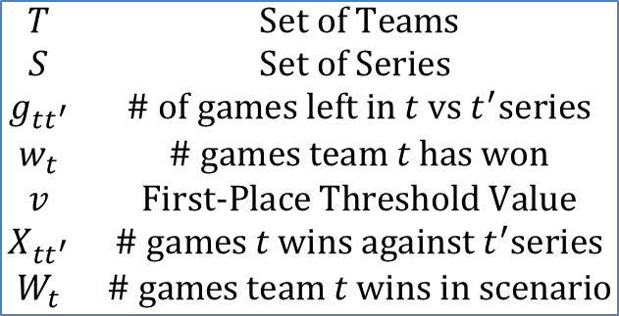
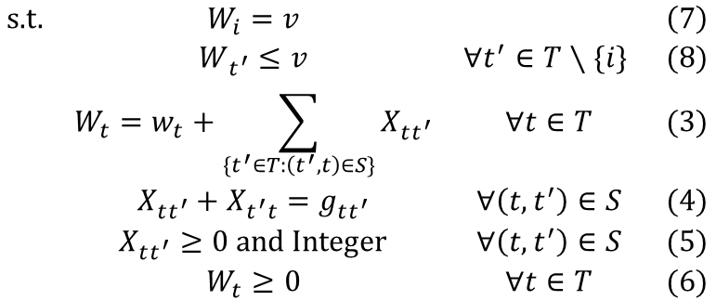
FPE Scenario: Team $i$ Finishes in First Place with $v$ Wins
$$\begin{matrix}T & \text{Set} \text{of} \text{Teams} \\ S & \text{Set} \text{of} \text{Series} \\ g_{tt^{′}} & \text{\# }\text{of} \text{games} \text{left} \text{in} t \text{vs} t^{′}\text{series} \\ w_{t} & \text{\# }\text{games} \text{team} t \text{has} \text{won} \\ v & \text{First}\text{−}\text{Place} \text{Threshold} \text{Value} \\ X_{tt^{′}} & \text{\# }\text{games} t \text{wins} \text{against} t^{′}\text{series} \\ W_{t} & \text{\# }\text{games} \text{team} t \text{wins} \text{in} \text{scenario}\end{matrix}$$
$$\begin{matrix}\text{s}\text{.}\text{t}. & W_{i}=v & & \left(7\right) \\ & W_{t^{′}}≤v & ∀t^{′}∈T∖\{i\} & (8) \\ & W_{t}=w_{t}+\sum_{{\{t}^{′}∈T:\left(t^{′}, t\right)∈S\}}{X_{tt^{′}}} & ∀t∈T & (3) \\ & X_{tt^{′}}+X_{t^{′}t}=g_{tt^{′}} & ∀\left(t,t^{′}\right)∈S & (4) \\ & X_{tt^{′}}≥0 \text{and} \text{Integer} & ∀\left(t,t^{′}\right)∈S & (5) \\ & W_{t}≥0 & ∀t∈T & (6)\end{matrix}$$
Notes:
To provide a user-friendly proof of the first-place elimination number of RIOT, we solve an additional MIP for each team that is still in contention for first place.
The solution to this MIP gives us a scenario in which team i finishes in first place with exactly V wins.
It’s easy to use the X variables to generate an automated proof that it’s possible for team i to finish in first place if they reach the threshold.
The more interesting part is generating an automated proof team i cannot finish in first place if they don’t reach the threshold. In other words, proving that this MIP is infeasible for v minus 1 without using math programming jargon.

Slide 9
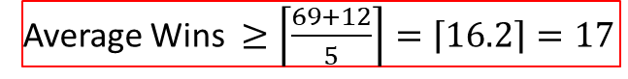
Threshold-Determining Set
Team | Wins | Losses
Seattle | 16 | 5
Las Vegas | 15 | 6
Connecticut | 14 | 6
Minnesota | 14 | 7
Chicago | 10 | 10
Total | 69
Series | Games Left
Chicago vs. Las Vegas | 3
Chicago vs. Minnesota | 1
Chicago vs. Seattle | 3
Connecticut vs. Las Vegas | 3
Las Vegas vs. Minnesota | 1
Minnesota vs. Seattle | 1
Total | 12
Average Wins $≥\left\lceil \frac{69+12}{5}\right\rceil =\left\lceil 16.2\right\rceil =17$
Notes:
Here’s an example of how we justify the first-place threshold on RIOT.
The group of five teams comprising Chicago, Connecticut, Las Vegas, Minnesota, and Seattle have already won a total of 69 games, and, as shown in the table on the right, will win at least another 12.
This means that on average each of the teams in this group will finish the season with at least 69+125= 16.2 wins.
Since win totals are integers, it follows that least one of the five teams in the group will finish the season with at least 17 wins.
We use a third MIP to find a minimum-size threshold-determining set to give the simplest explanation of the FPE number.
In the interest of time, I will skip past that formulation to illustrate how we use the solutions of the models to generate a justification of the first-place elimination number.

Slide 10
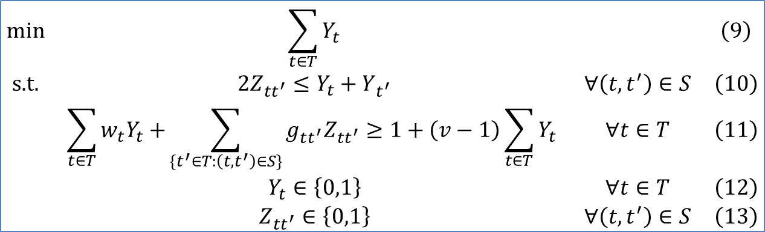
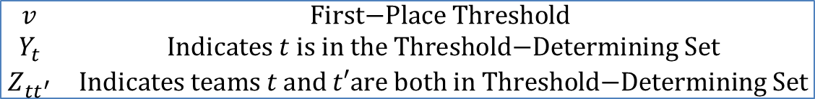
Schwartz MIP: Smallest Set of Teams Determining the First-Place Threshold
$$\begin{matrix}v & \text{First}\text{−}\text{Place} \text{Threshold} \\ Y_{t} & \text{Indicates} t \text{is} \text{in} \text{the} \text{Threshold}\text{−}\text{Determining} \text{Set} \\ Z_{tt^{′}} & \text{Indicates} \text{teams} t \text{and} t′\text{are} \text{both} \text{in} \text{Threshold}\text{−}\text{Determining} \text{Set}\end{matrix}$$
$$\begin{matrix}\text{min} & \sum_{t∈T}{Y_{t}} & & \left(9\right) \\ \text{s}\text{.}\text{t}. & {2Z}_{tt^{′}}≤Y_{t}+Y_{t^{′}} & ∀\left(t,t^{′}\right)∈S & \left(10\right) \\ & \sum_{t∈T}{{w_{t}Y}_{t}+}\sum_{\{t^{′}∈T:\left(t,t^{′}\right)∈S\}}{{g_{tt^{′}}Z}_{tt^{′}}}≥1+\left(v−1\right)\sum_{t∈T}{Y_{t}} & ∀t∈T & \left(11\right) \\ & Y_{t}∈\left\{0,1\right\} & ∀t∈T & \left(12\right) \\ & Z_{tt^{′}}∈\left\{0,1\right\} & ∀\left(t,t^{′}\right)∈S & \left(13\right)\end{matrix}$$
Notes:
We use a third MIP to find a threshold-determining set of teams.
As I illustrated in the WNBA example, any set of teams will necessarily win at least a certain total number of games by the end of the season. That’s calculated here.
To be a threshold-determining set, that total must be larger than the maximum total number of games those teams will win if none of them reach the first-place threshold.
Since we want the proof to be concise, we minimize the number of teams in the threshold-determining set.
Putting the sequence of MIPs together gives us a justification of the FPE number that goes something like this …

Slide 11
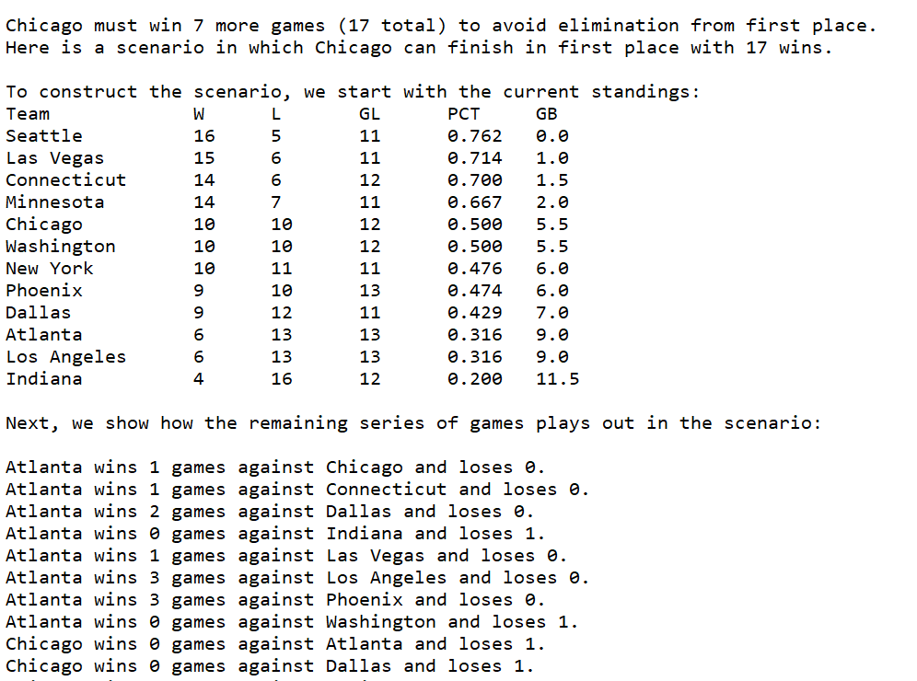
Explaining Chicago’s First-Place Elimination Number
Notes:
We start out by explaining what we mean when say that Chicago’s FPE is 7.
Then we show the current standings and essentially list out the scenario represented by the X variables.

Slide 12
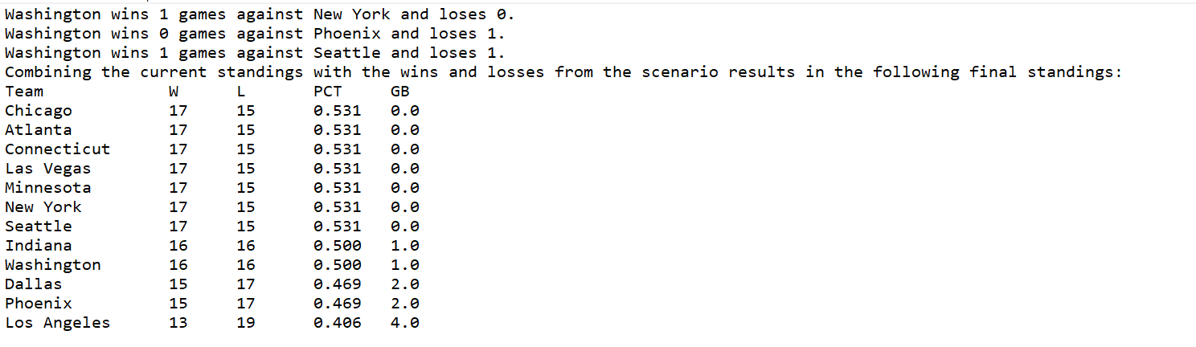
Explaining Chicago’s First-Place Elimination Number
Notes:
Then, we show the final standings in the scenario.
As you can see, Chicago finishes the season in a tie for first place in this scenario with 17 wins.

Slide 13
Explaining Chicago’s First-Place Elimination Number
To see why Chicago must win at least 7 more game(s) to avoid elimination from first place, consider what happens if they only win 6.
In other words, suppose that Chicago wins 6 more games and loses 6 to finish the season with 16 wins and 16 losses.
Connecticut has already won 14 games.
Las Vegas has already won 15 games.
Minnesota has already won 14 games.
Seattle has already won 16 games.
Connecticut and Las Vegas have 3 game(s) left in their series.
Las Vegas and Minnesota have 1 game(s) left in their series.
Minnesota and Seattle have 1 game(s) left in their series.
So, the 4 teams listed above will finish the season with a total of at least 64 wins.
Notes:
Then to complete the justification of the FPE number, we interpret the solution to the modified Schwartz MIP.
This gives us a more concise explanation of why Chicago cannot finish in first place with fewer than 17 wins that goes like this …

Slide 14
Explaining Chicago’s First-Place Elimination Number
Furthermore, Chicago and Las Vegas have 3 game(s) left in their series.
Chicago and Minnesota have 1 game(s) left in their series.
Chicago and Seattle have 3 game(s) left in their series.
In this scenario, Chicago would win at most 6 of 7 these games and lose at least 1.
So, the 4 teams listed above would finish the season with a total of at least 65 wins in this scenario.
The average number of wins that each of the 4 teams listed above would have at the end of the season would be at least 16.25.
Therefore, at least one team would finish the season ahead of Chicago with 17 or more wins.
Notes:
Chicago has seven games left on schedule against those teams. We’re supposing that they will lose one of those games.
That means the four-team group will win at total of at least 65 games which means that at least one of them will end up with at least 17 wins.

Slide 15
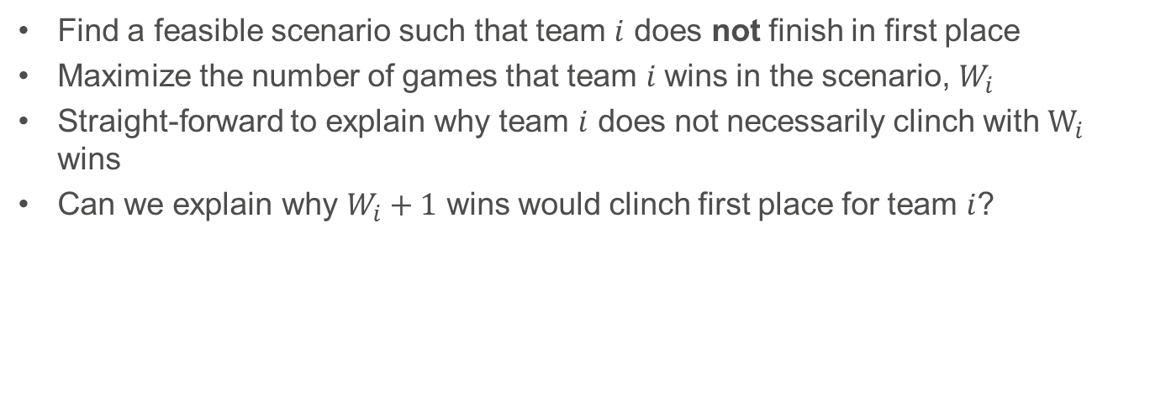
First-Place Clinch Number
Find a feasible scenario such that team $i$ does not finish in first place
Maximize the number of games that team $i$wins in the scenario, $W_{i}$
Straight-forward to explain why team $i$ does not necessarily clinch with $W_{i}$ wins
Can we explain why $W_{i}+1$ wins would clinch first place for team $i$?

Slide 16
First Place Clinch Example: KBO 9/12/21
Team | W | L | GL | FPC
KT | 61 | 39 | 40 | 37
Samsung | 58 | 45 | 35 | *
LG | 55 | 43 | 43 | 43
Kiwoom | 56 | 51 | 36 | *
NC | 49 | 49 | 42 | *
SSG | 51 | 51 | 37 | *
Doosan | 49 | 50 | 42 | *
Lotte | 47 | 54 | 40 | *
KIA | 38 | 56 | 44 | *
Hanwha | 38 | 64 | 35 | *
98
(+3)
Notes:
Here’s a quick example of we justify the first-place clinch number using our KBO standings.
KT’s FPC is 37.
For an OR audience the proof the formulation the MIP that we solve, which maximizes KT’s win total subject to at least one other team finishing the season with a record as good or better than KT’s.
For a general audience, it’s easy to generate a proof that 37 more wins guarantees that KT will finish in first place.
KT has 61 wins so far. So, we’re saying they reach the threshold of 98 wins they will clinch first place.
They have 40 games left, so our proof considers scenarios in which they lost at most 3 more games this season.

Slide 17
Why KT Clinches First Place with 37 Wins
Team | W | L | GL | Min. Losses to KT | Max W.
Samsung | 58 | 45 | 35 | 0 | 93
LG | 55 | 43 | 43 | 4 – 3 = 1 | 97
Kiwoom | 56 | 51 | 36 | 0 | 92
NC | 49 | 49 | 42 | 8 – 3 = 5 | 86
SSG | 51 | 51 | 37 | 0 | 88
Doosan | 49 | 50 | 42 | 7 – 3 = 4 | 87
Lotte | 47 | 54 | 40 | 5 – 3 = 2 | 85
KIA | 38 | 56 | 44 | 4 – 3 = 1 | 81
Hanwha | 38 | 64 | 35 | 4 – 3 = 1 | 72
(55 + 43 - 1)
Notes:
LG has 55 wins and 43 games left to play, so they can also reach the 98 win threshold.
But, 4 of LG’s remaining games are against KT. In our scenario, KT will lost at most 3 of those games and LG will lose at least 1.
That means that if KT gets to 98 wins then LG can get to at most 97.
In general, the proof for the FPC number use this kind of simple arithmetic to show by winning that number of its remaining games, the team in question is guaranteed to finish with more

Slide 18
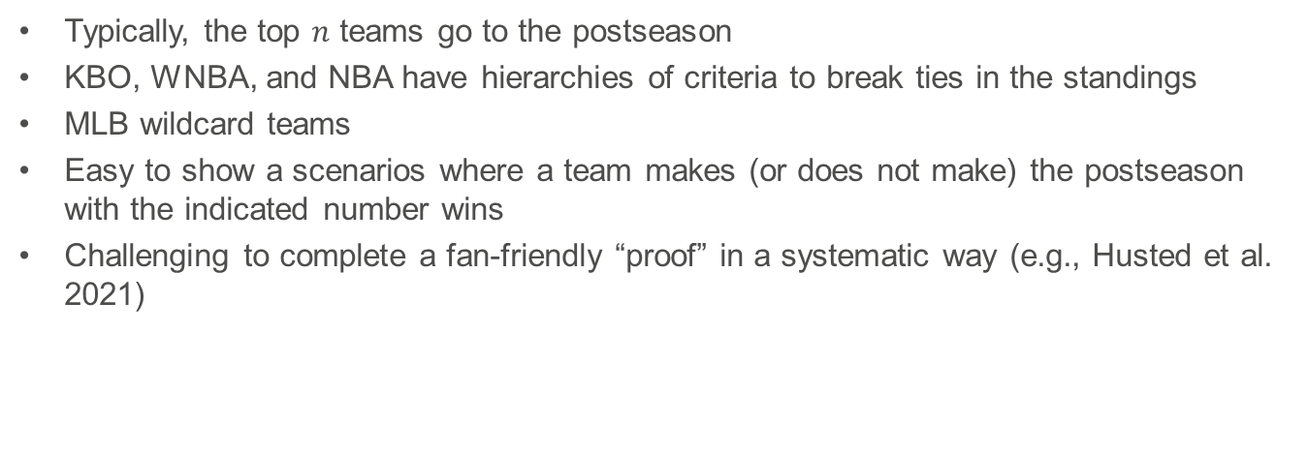
Challenge: Explaining Postseason Clinch and Elimination Numbers
Typically, the top $n$ teams go to the postseason
KBO, WNBA, and NBA have hierarchies of criteria to break ties in the standings
MLB wildcard teams
Easy to show a scenarios where a team makes (or does not make) the postseason with the indicated number wins
Challenging to complete a fan-friendly “proof” in a systematic way (e.g., Husted et al. 2021)
Thank you for your attention. Please send comments and questions to olinick@smu.edu.
InformsSports@twitter.com
VTA56 spORts I
VTB56 spORts II

